Slide 1
IBM University Engagement Project Submission
“Exploring the Power of Agentic AI with IBM Granite and IBM Bob”

Slide 2

Project Title – IdeaForge AI :Smart Business Idea Generator Agent
Domain of Project – Business and Entrepreneurship
Student Name | Recent Passport Photo | Email ID | Mobile number [WhatsApp]
Lovely Patel |  | lovelypatel1942004@gmail.com | 7895101895

Slide 3
Problem Statement -
Problem Statement: Smart Business Idea Generator Agent
The Challenge
In the digital era, innovation is crucial, but individuals, students, researchers, and organizations often struggle with idea generation. Brainstorming sessions are unstructured, inspiration is scattered across articles, videos, and social media, and existing tools focus on text-only prompts without context-awareness. The challenge is not just to suggest random ideas but to synthesize creativity, context, and relevance into intelligent, actionable ideas for diverse domains such as startups, research, content creation, or product development.
The Objective
Build an agentic AI Smart Idea Generator that empowers users with contextual, innovative, and multimodal ideation. The solution should:
Fuse Knowledge Sources: Pull insights from articles, research papers, trend analysis, and social platforms to generate contextual and current ideas.
Enable Multimodal Brainstorming: Accept inputs like text prompts, images (e.g., product sketches), or voice notes and refine them into structured, creative suggestions.
Create a Predictive & Agentic Layer: Identify trending domains (e.g., AI in healthcare, sustainable energy), forecast idea relevance, and recommend high-impact directions.
Visualize Idea Maps: Provide an interactive dashboard that organizes ideas into categories, impact scores, and feasibility maps, helping users explore and refine concepts quickly.
Tech Stack
IBM Langflow / IBM Orchestrate + IBM Models

Slide 4
Proposed Solution -
Proposed Solution: AI-Powered Smart Business Idea Generator Agent
The proposed solution is a multi-agent AI-powered Smart Business Idea Generator built using IBM Bob, IBM watsonx.ai, IBM Langflow/Orchestrate, and Granite Models. It helps users generate innovative, context-aware, and practical business ideas by combining AI reasoning with real-time market insights.
The solution uses a Retrieval-Augmented Generation (RAG) pipeline to retrieve information from research papers, market reports, startup databases, and industry trends. This knowledge is stored in a vector database, enabling accurate and relevant idea generation.
The system consists of four key agents:
Knowledge Agent: Retrieves and summarizes market trends, research, and industry insights.
Idea Generation Agent: Generates personalized business ideas based on user interests, budget, and domain.
Trend & Feasibility Agent: Evaluates market potential, feasibility, and business risks.
Multimodal Brainstorming Agent: Accepts text, voice, or image inputs and converts them into structured business concepts.
The solution includes a user-friendly dashboard (Streamlit/React) that displays generated ideas, feasibility scores, market trends, and implementation roadmaps.
IBM Bob orchestrates the agent workflows, while watsonx.ai manages AI models, embeddings, and governance. Granite Models power reasoning, summarization, and idea generation.
Overall, the solution provides an end-to-end intelligent business ideation platform that enables users to quickly generate, evaluate, and refine innovative business ideas with AI-driven insights.

Slide 5
Technology Used
IBM Bob platform -For designing and orchestrating multi-agent workflows visually
IBM Granite model - ibm-granite-3-3-8b – For natural language understanding, reasoning, and personalization
IBM Cloud – It provides the infrastructure to build, deploy, and scale efficiently. IBM Cloud enables a reliable, secure, and scalable environment for deploying the IdeaForge AI.
RAG– RAG to fetch real data first, then generate intelligent answers, making the Idea Forge more trustworthy and effective.
IBM Watsonx.ai - For model deployment, embeddings, and AI governance.

Slide 6
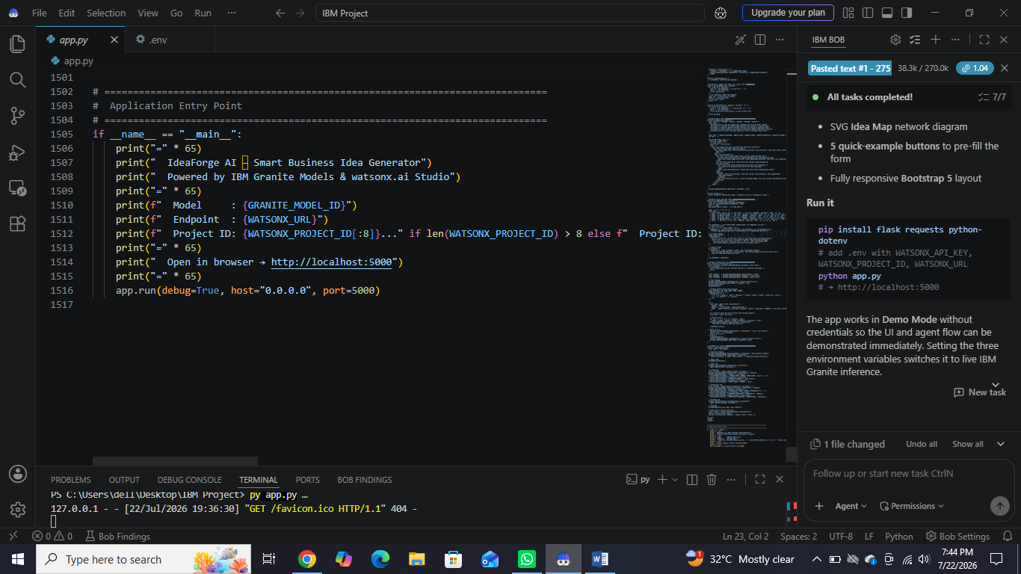
Required Files created using IBM bob -
App.py
Style.css
.env
Index.html

Slide 7
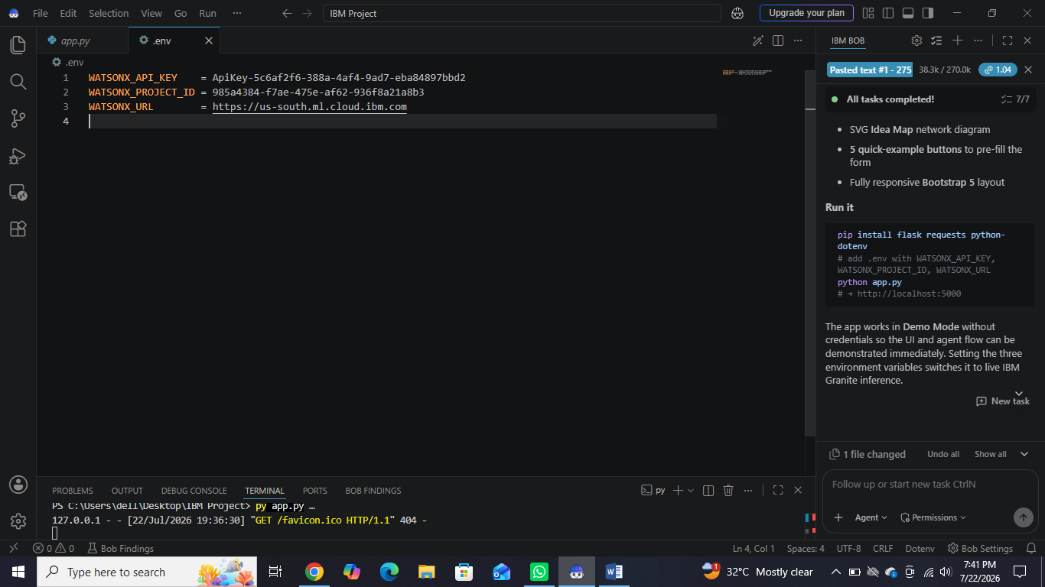
IBM Bob Screenshots:

Slide 8
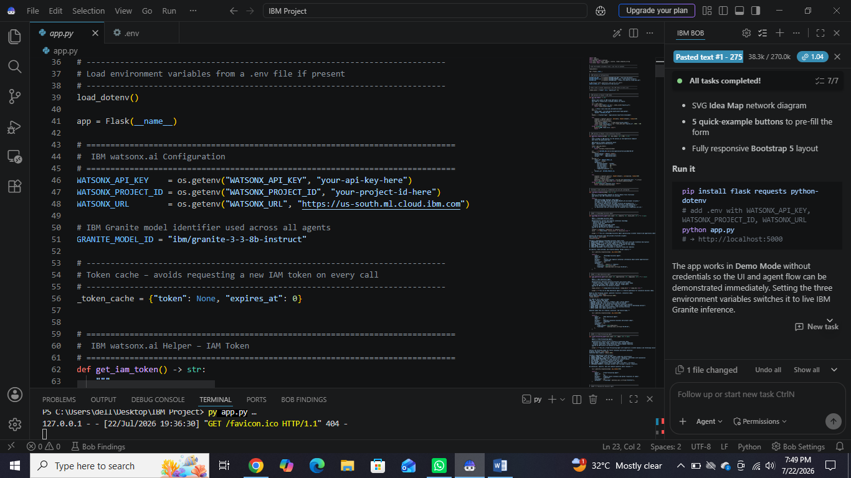

Slide 9
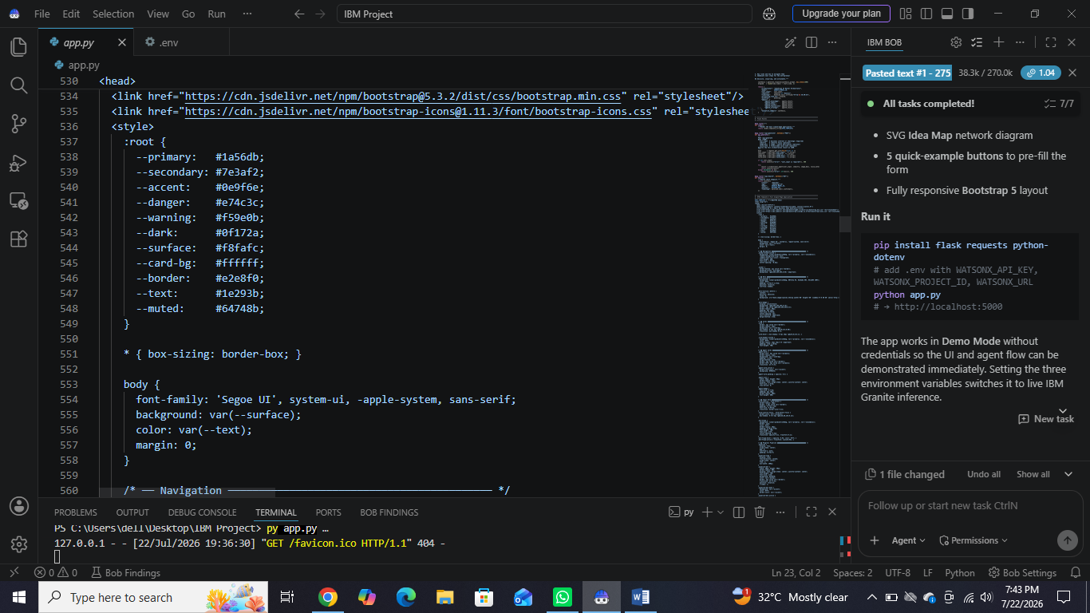

Slide 10
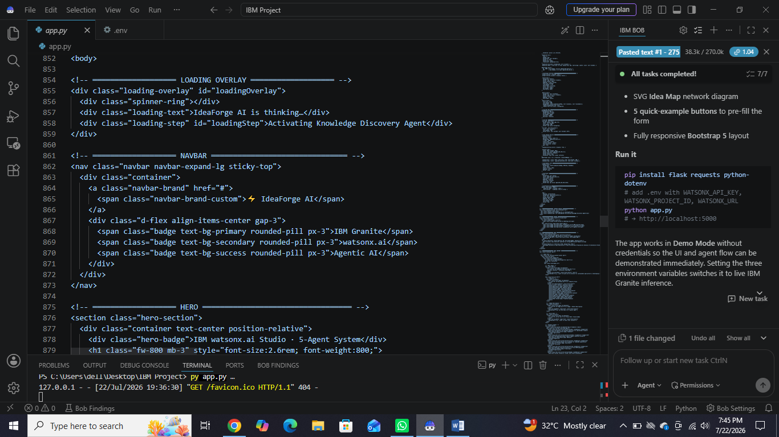
·

Slide 11

Role of Agentic AI in the solution
Role of Agentic AI in Idea Forge
Agentic AI enables the Idea Forge to function as an intelligent, autonomous system rather than a simple chatbot. Using IBM watsonx.ai and IBM Granite models, it coordinates multiple specialized agents to deliver smart business idea.
Each agent performs a specific role—such as collect and organize contextual information, generating innovative business and project idea, predict future relevance of generated ideas, and evaluate practicality of ideas —while working collaboratively. This multi-agent approach ensures efficient task execution and accurate results.
Agentic AI also brings context awareness, understanding user details. It supports real-time adaptation, continuously updating suggestions based on user inputs.
Additionally, agents communicate with each other, enabling better decision-making and improved outcomes.
Overall, Agentic AI makes the system proactive, personalized, and goal-driven, acting like a smart business idea generator.

Slide 12
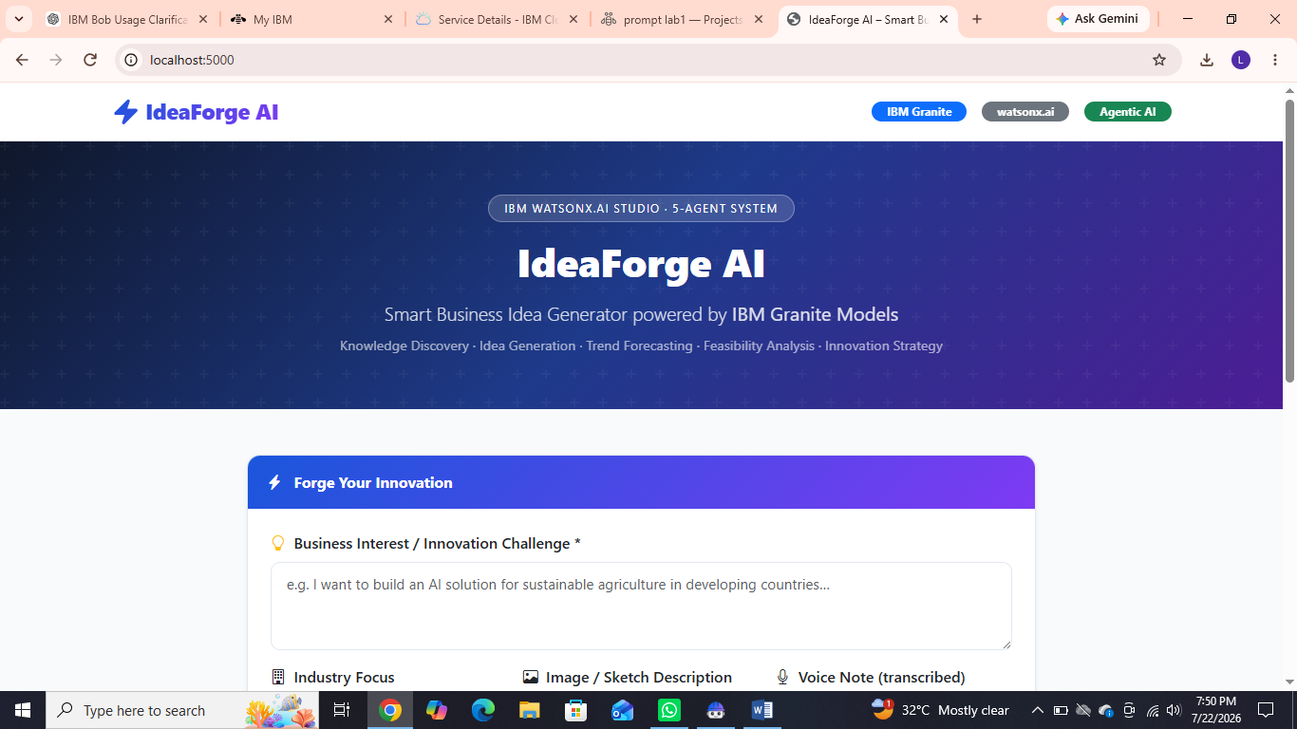
Project Output Screenshot

Slide 13
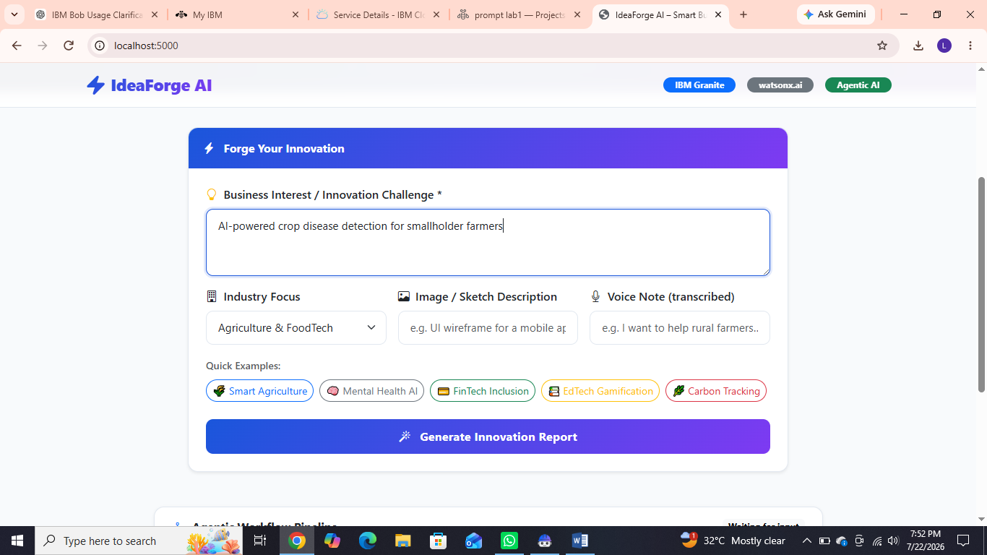
Project Output Screenshot

Slide 14
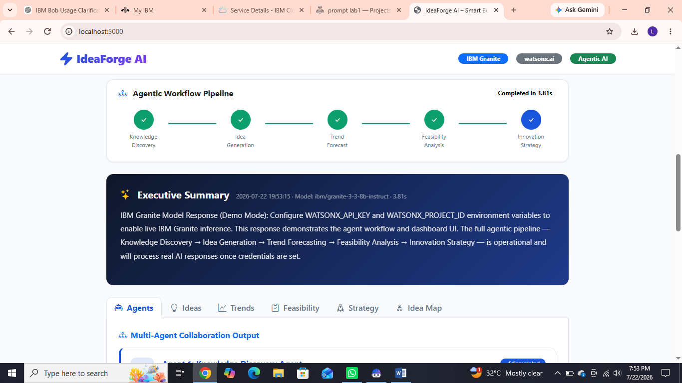
Project Output Screenshot
Please put IBM Bob output screenshots with 2-3 prompts.
You can take 2-3 more slides for each screenshot
·
·
·

Slide 15
Novelty and Uniqueness
The proposed Idea Forge stands out by combining Agentic AI, RAG, and personalization into a single intelligent system.
Multi-Agent Intelligence – Instead of a single chatbot, multiple specialized agents collaborate to deliver accurate and context-aware idea guidance.
RAG-Based Accuracy – Integrates real-time data retrieval with AI generation, reducing misinformation and ensuring trustworthy recommendations.
Real-Time Feedback Loop – Continuously adapts recommendations based on user
Multi-Modal Input – Supports text, voice, and image-based meal tracking for better usability.
Scalable & Enterprise-Ready – Built on IBM watsonx.ai with IBM Granite models, ensuring reliability and governance.
This makes the solution a smart, adaptive, and proactive idea generator, not just a static AI recommendation tool.

Slide 16
Git Hub Link
Github URL – https://github.com/lovely-03/Idea-Forge-AI

Slide 17
Future Scope
Integrate real-time market trends, startup funding, and competitor analysis for more accurate business recommendations.
Support multiple languages to make the platform accessible to global users.
Provide AI-generated business plans, financial projections, and pitch decks for investors.
Enable team collaboration for brainstorming and idea refinement.
Integrate with cloud platforms and business tools (e.g., CRM, project management, analytics) for end-to-end startup planning.
Continuously improve recommendations using user feedback and machine learning to deliver more personalized and successful business ideas.

Slide 18
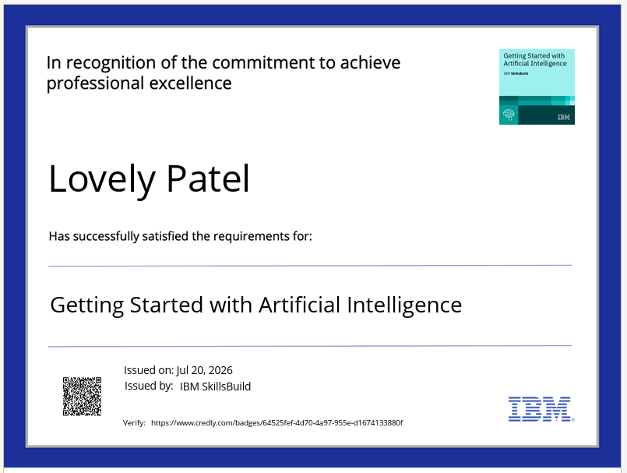
Certificates Earned:

Slide 19
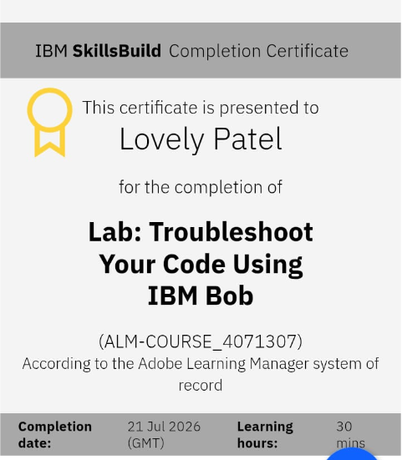
Certificates Earned:​

Slide 20


